Slide 1

EU Contract Networks
Kai Foerster, Steve Kerr,
Lukas Lehmann, Danial Riaz
27 Nov 2023

Slide 2
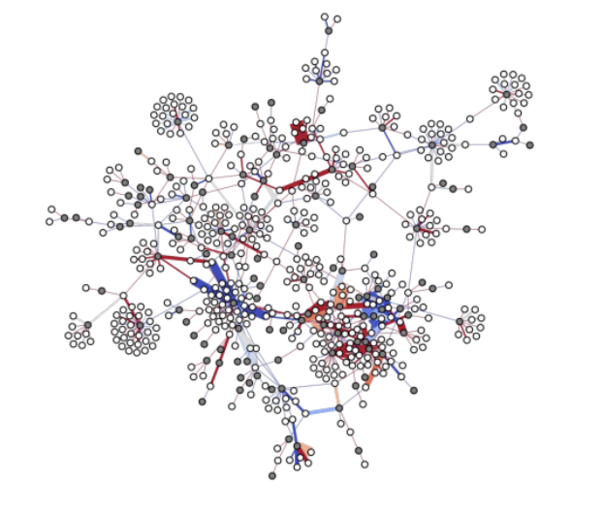
Agenda
Background
Dataset
Networks Over Time
Comparison with Empirical Models
Link Prediction
Conclusion
Notes:
Background + dataset: 3 min - Kai
Network over time: 1 min - Lukas
Comparison with EM: 4 min – Lukas and Danial
Link prediction: 1.5 min – Steve / Kai
Conclusion: 0.5 min – Steve / Kai

Slide 3
Background

Slide 4
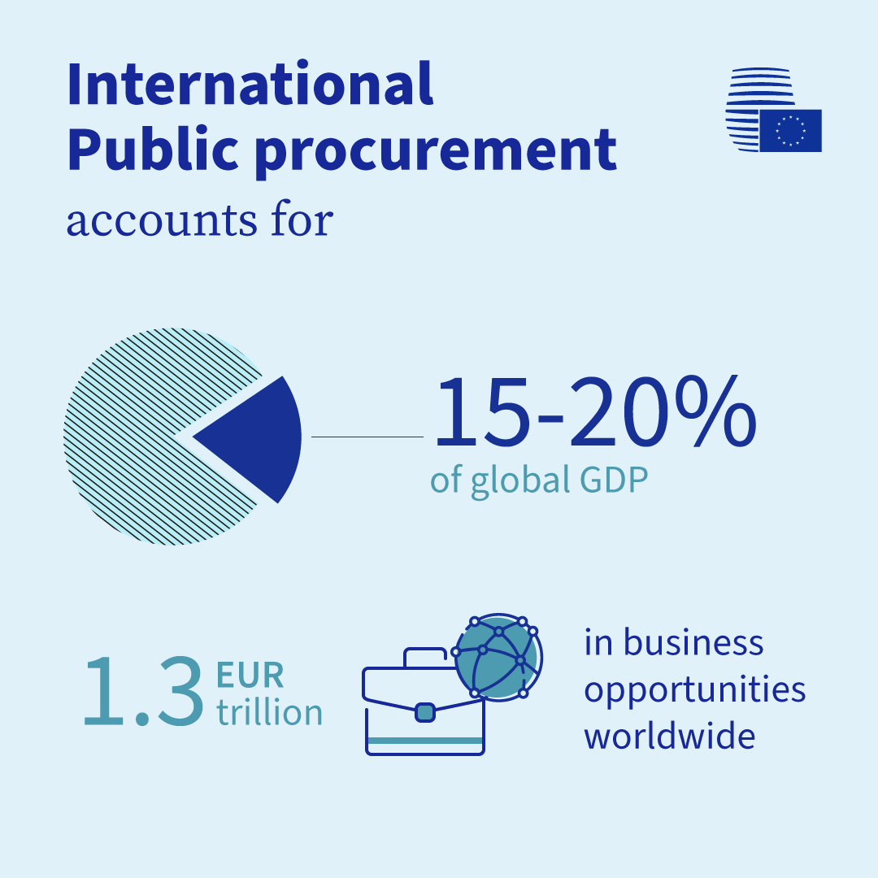
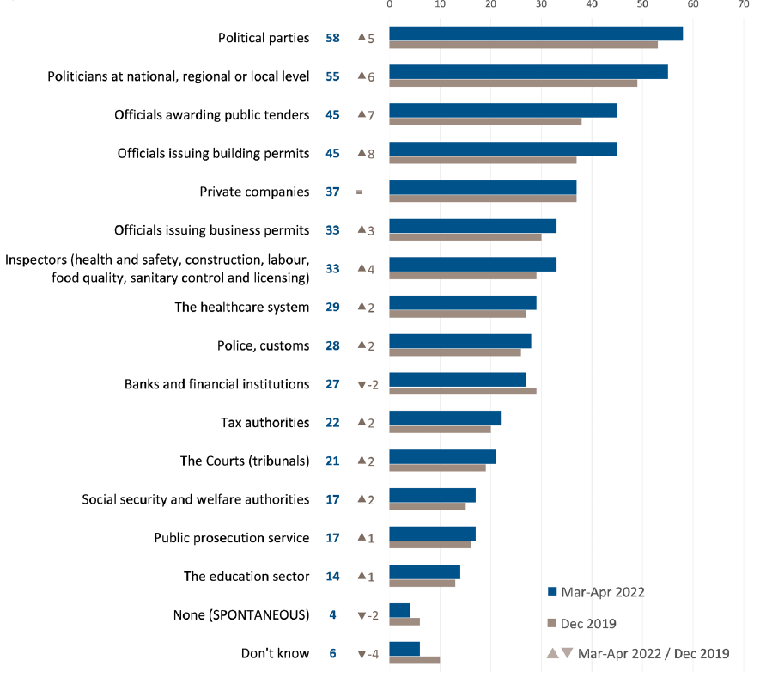
Corruption in public procurement
Corruption = “deliberate restriction of open and fair access to public resources for the benefit of connected actors” (Wachs, Fazekas and Kertesz, 2019, p. 45)
Source: European Comission (2022), European Council (2022)
Notes:
Perennial issue for governments (including adv. democracies)
Consequences:
Slows growth and innovation
Subverts democracy
Compounds inequality

Slide 5


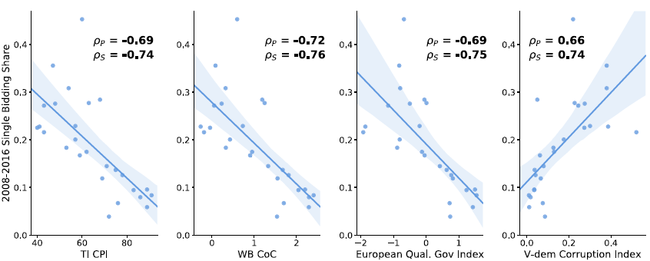

Corruption risk in contracting markets: a network science perspective by Wachs, Fazekas and Kertesz
Corruption is traditionally measured via surveys (often flawed)
For each contract, use single bidding rate as proxy for corruption risk
0 if there was competition
1 if there was no competition
Single bidding rate correlated with survey-based measures of corruption
Note: TI CPI stands for Transparency International‘s Corruption Perception Index, WB CoC stands for World Bank‘s Control of Corruption Index, European Qual. Gov Index stands for the Quality of Government Institute‘s European Quality of Governance Index and V-dem Corruption Index stands for Varieties of Democracy‘s Corruption Index.
Source: Wachs, Fazekas and Kertesz (2019)

Slide 6
Dataset

Slide 7
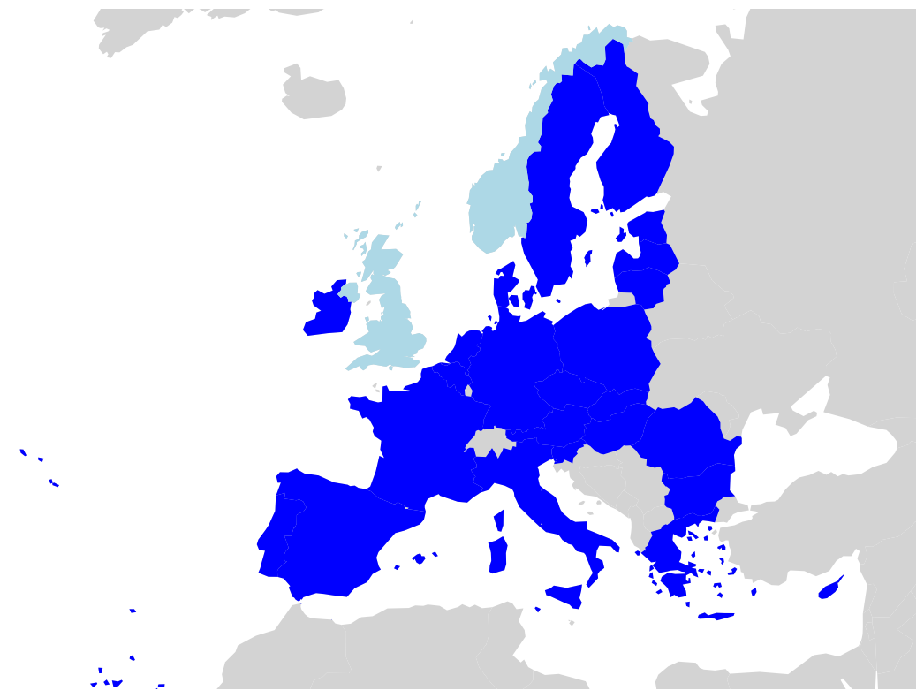
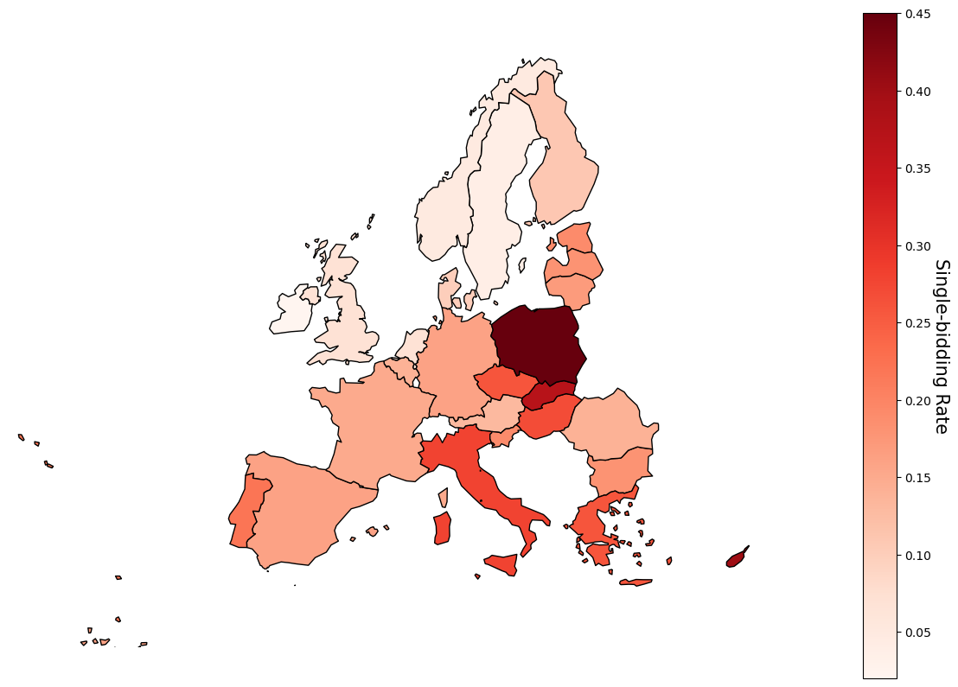
Dataset: EU procurement contract networks (2008-2016)
4M+ public contracts (2008-2016)
Bipartite networks of public institutions (“buyers/issuers”) and firms (“suppliers/winners“)
26 EU countries (excl. LU, MT, HR) + UK + NO
Single-bid rates used as a proxy for corruption
Source: Eurostat (2020), Wachs, Fazekas and Kertesz (2019)
Notes:
EU law requires public contracts above a certain amount to be published on Tenders Electronic Daily

Slide 8
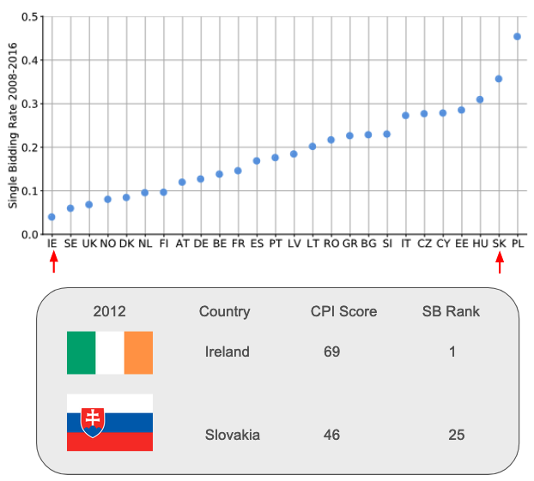
Case Studies: Ireland & Slovakia
Ireland and Slovakia
Similar population sizes (IE – 4.6M, SK- 5.4M in 2012)
2012 – Year Selection
Middle of dataset (2008-2016)
Significant difference in single-bidder rates
Closeness of CPI scores from Transparency International

Slide 9
Summary Statistics
Country | # Contracts | # Winners | # Issuers | <K> Winners | <K> Issuers
Ireland | 2,713 | 1,587 | 208 | 1.7 | 13.1
Slovakia | 2,654 | 1,068 | 344 | 2.4 | 8.1
While Ireland and Slovakia have a similar number of contracts, Slovakia has 33% fewers winners despite having 65% more public institutions.
Additionally, the average degree for firms is lower in Ireland than in Slovakia, and the average degree for public institutions is higher in Ireland than in Slovakia.

Slide 10
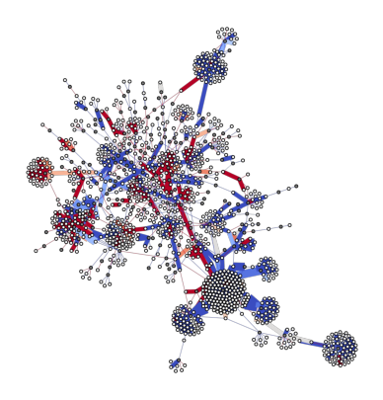
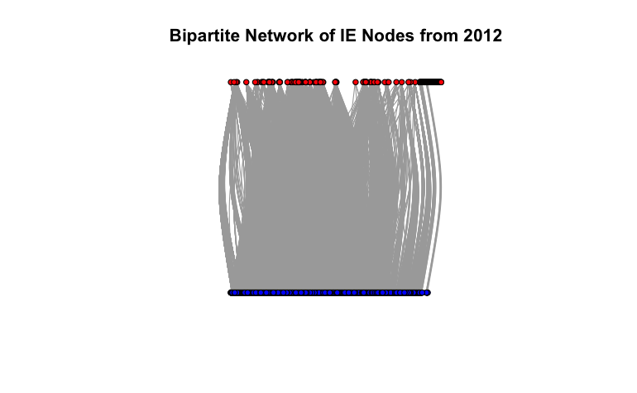
Network Properties
On the Left: Bipartite network structure Ireland 2012
Red nodes – issuers of contracts
Blue nodes – winners of contracts
On the Right: Slovakia 2012 in spring layout
Gray nodes are issuers of contracts.
White nodes are winners of contracts.
The weight of the edges (thickness) indicates the log count of contracts between the issuers and winners.
The color of the edges represents the share of single-bid contracts among these connections; the more red an edge is, the higher the proportion of single-bid contracts.

Slide 11
Networks Over Time

Slide 12

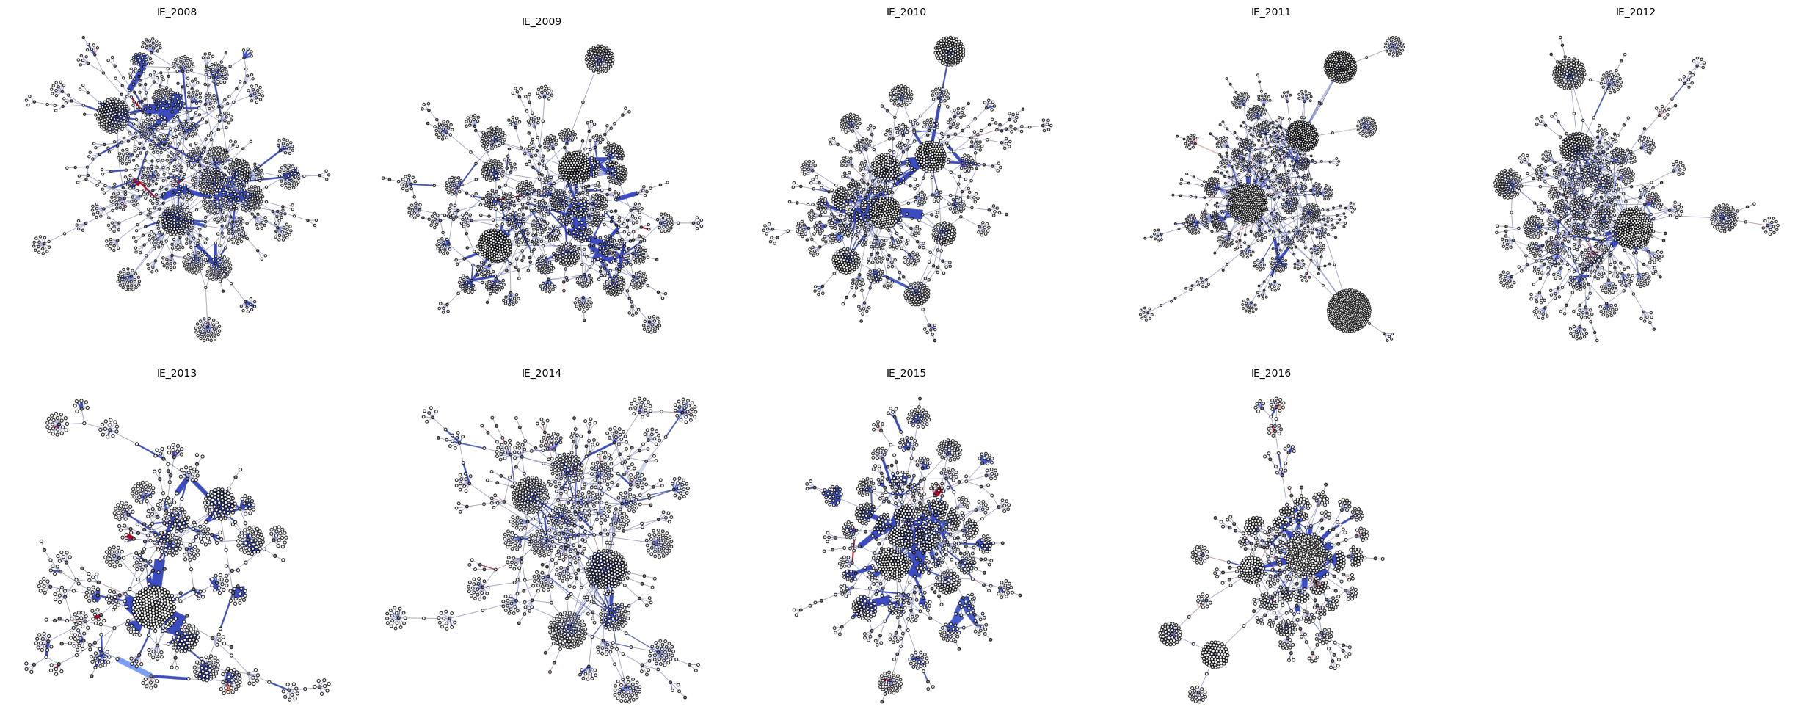
Ireland

Slide 13

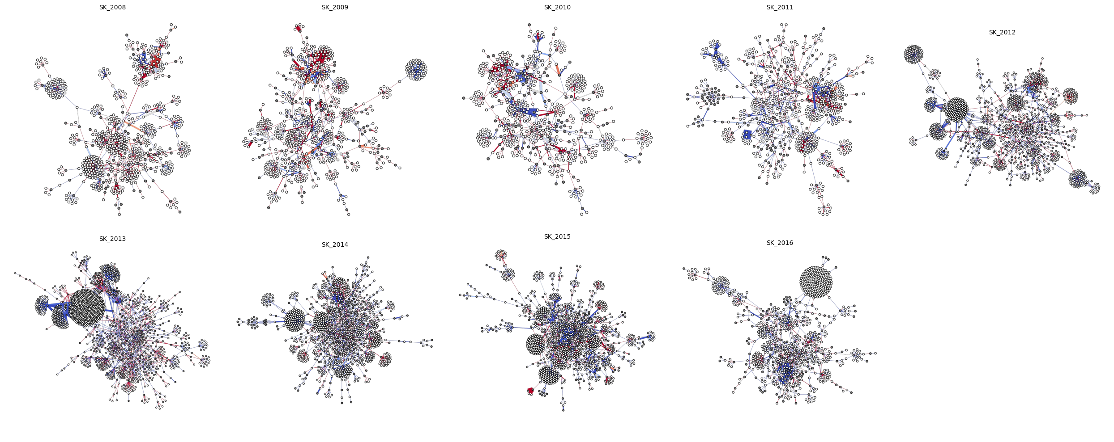
Slovakia

Slide 14
Comparison with Empirical Models

Slide 15
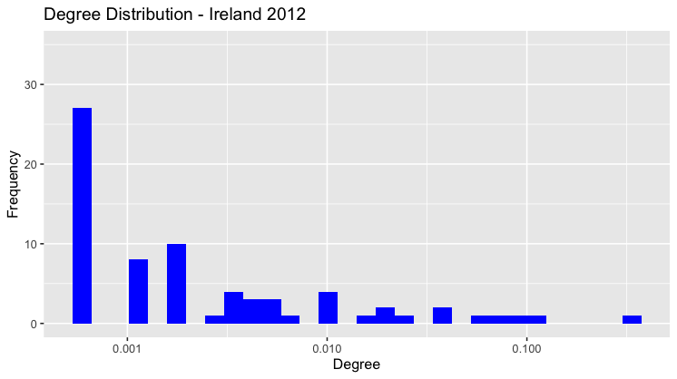
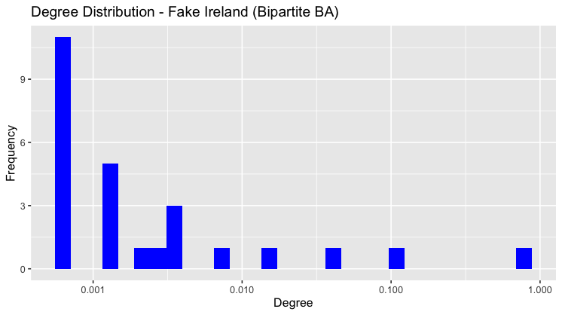
Comparing our degree distribution to the degree distribution of the Barabási–Albert model
Degree Distributions
Both networks are scale-free
Similar distribution, but greater range on x-axis
All winners can work with all issuers in simulation... no specialization

Slide 16
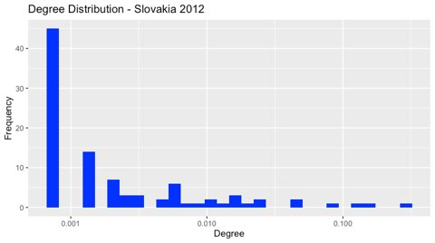
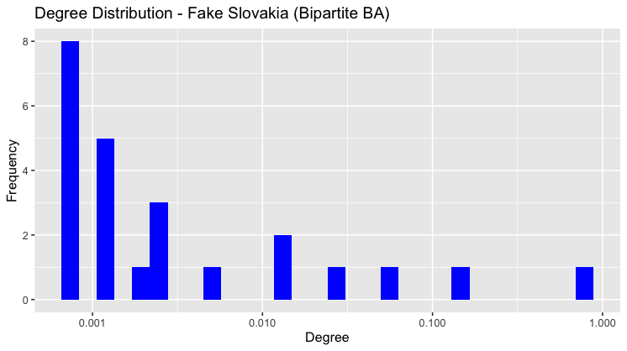
Degree Distributions
Comparing our degree distribution to the degree distribution of the Barabási–Albert model

Slide 17
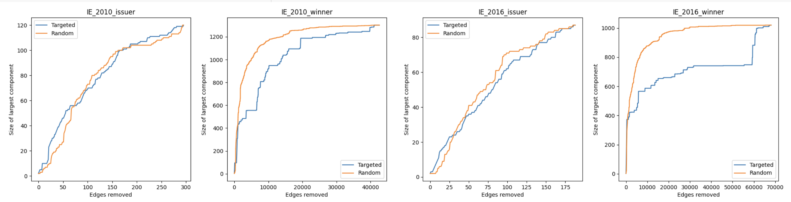
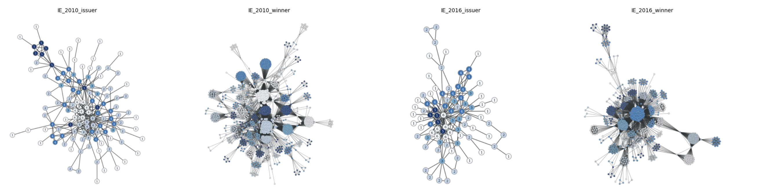
Comparing inverse percolations in the EU Network with the Albert Barabasi Model
Inverse Percolations
Assessing the robustness of the Network
Random Networks:
A randomly picked node is likely to have an average degree of the network <k>
Doesn’t matter which edge you remove first
There’s a finite fraction of nodes at which we lose the Giant Component
Scale Free (AB) Network:
No <k>
Large # of Nodes with small k
Small # of Nodes with large k (Hubs)
A randomly removed edge is more likely to be a node with smaller k
More robust against random failures but are not tolerant to a coordinated attack

Slide 18
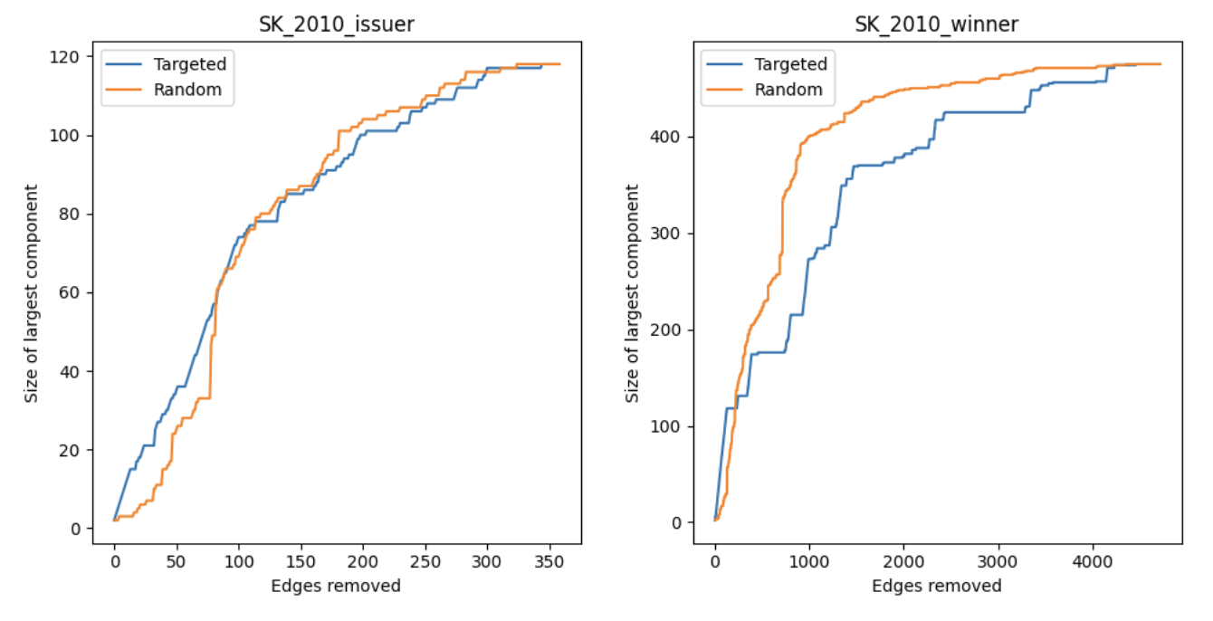
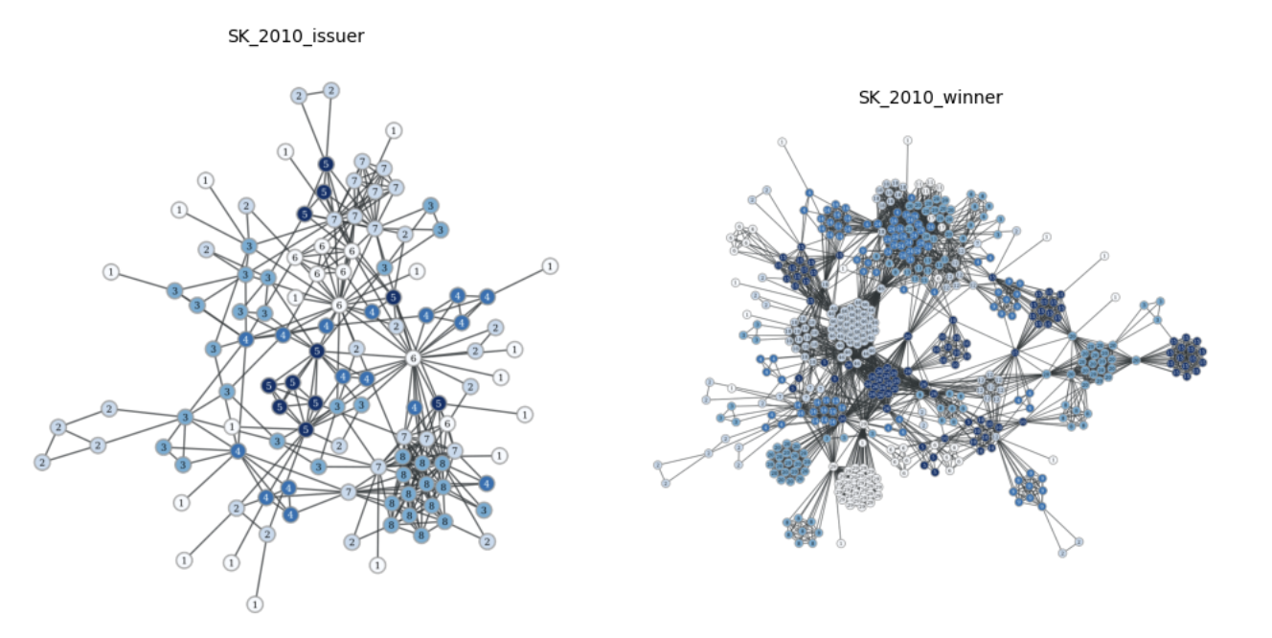
Comparing inverse percolations in the EU Network with the Albert Barabasi Model
Inverse Percolations
Similar results seen for Slovakia in 2010 as well

Slide 19
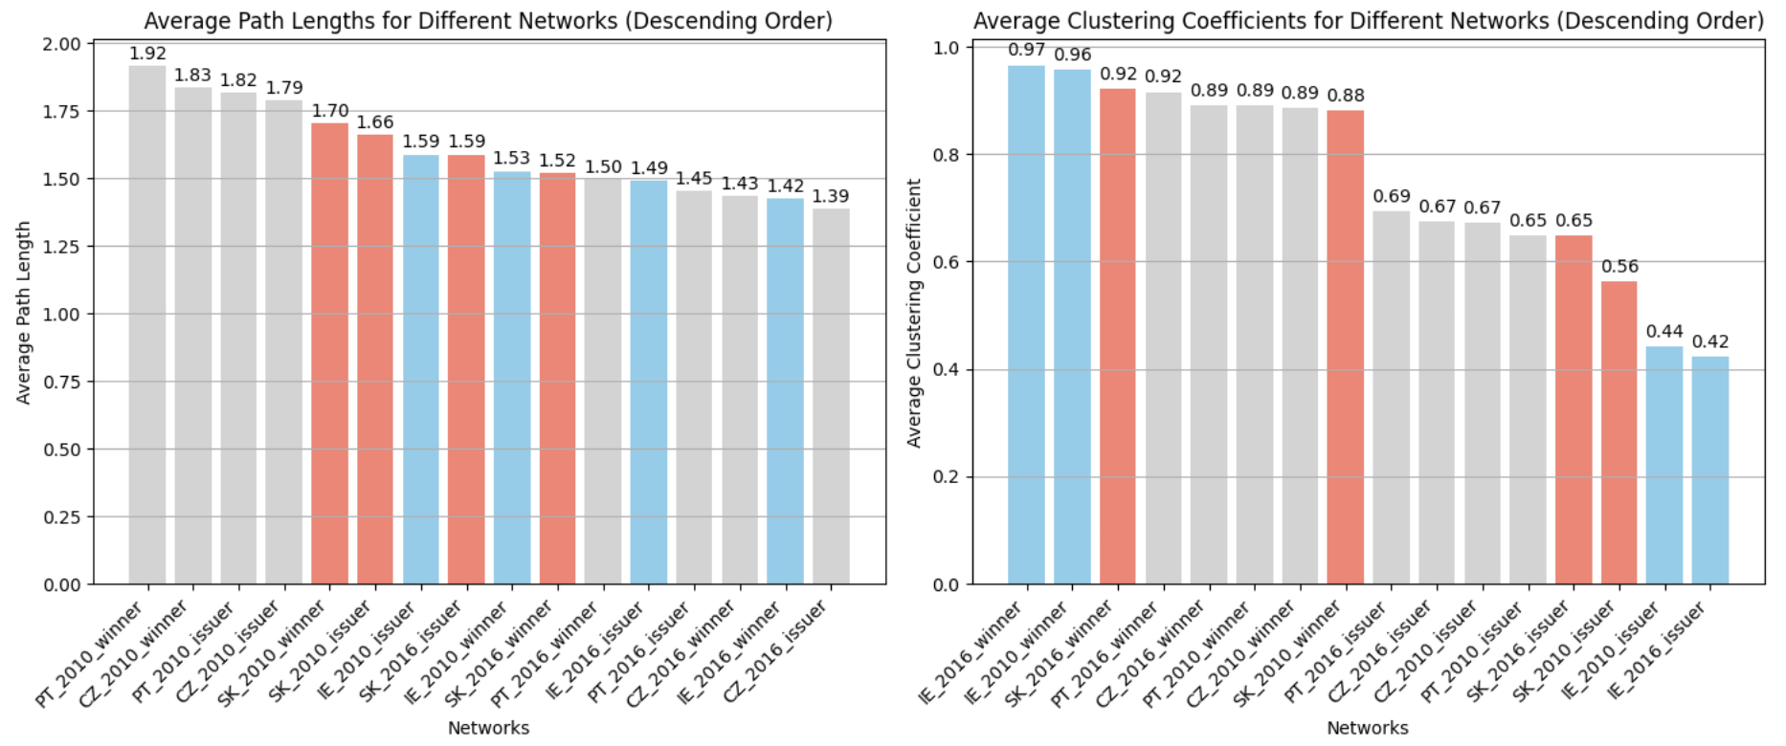
Average Path lengths and Clustering Coefficients
Small number of Avg. path length signifies a more interconnected network. It takes a smaller number of ‘hops’ on average to reach from one node to another
Lower Clustering Coefficient signifies nodes are connected to the overall network rather than being more connected to their own clusters

Slide 20
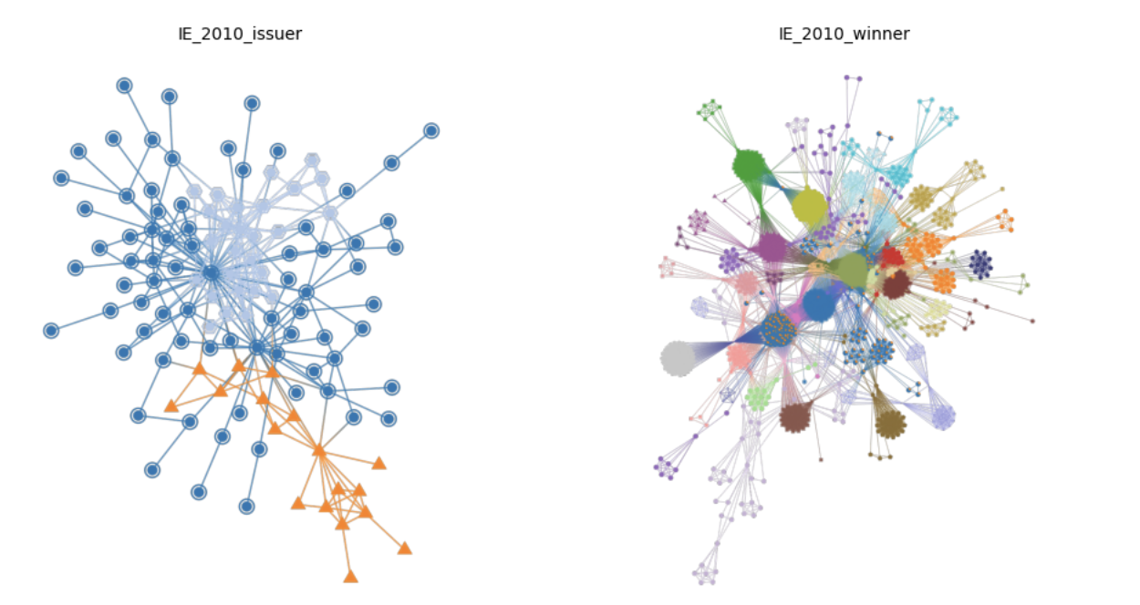
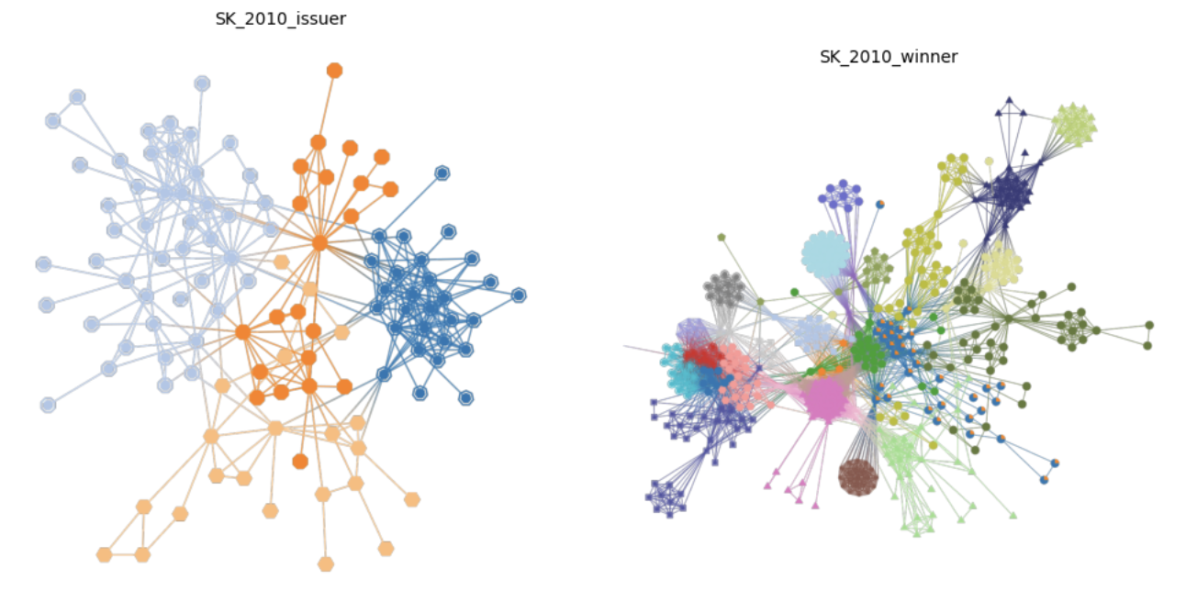
Limitations of the Albert Barabasi model and the use of Stochastic Block Model
Block Models
As we know, the Albert Barabasi model does a good job in reproducing percolations, small world, short paths and hubs but not a great job at identifying assortative behaviour (communities)
We therefore look at the Stochastic Block model
On the Right:
Each color corresponds to a different block or community identified by the blockmodel algorithm.
Nodes with the same color belong to the same block
Winners have a greater number of communities in general
More of an inferential/descriptive model rather than an explanatory one.

Slide 21
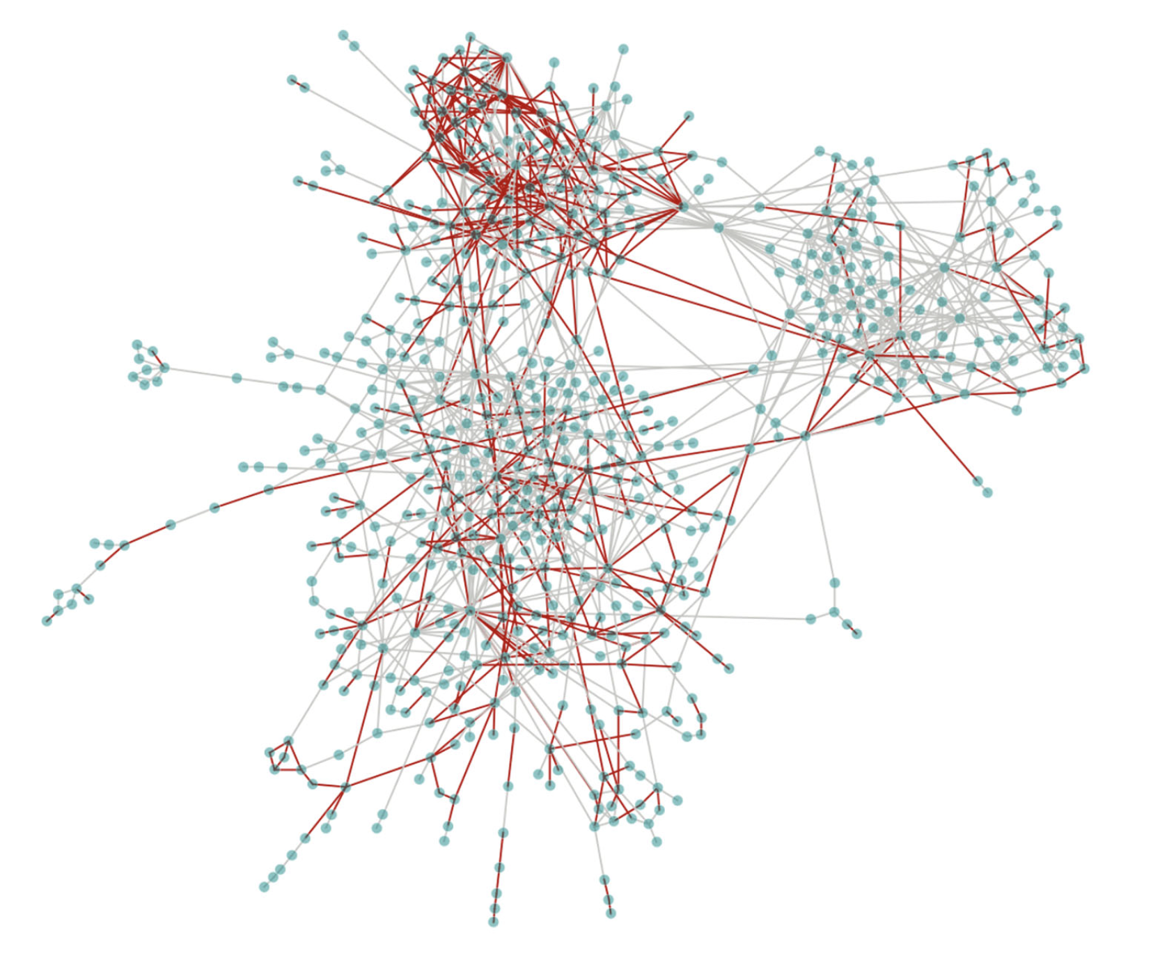
Hungarian procurement market
A more explanatory community detection
The 2014 Hungarian procurement market. Plotted the largest connected component of the network,
Filtering out nodes involved in less than three contracts for the sake of visualization.
Nodes are buyers and suppliers of contracts
Each edge represents that the buyers and suppliers have a contract.
Edges are colored red if the single-bidding rate on the edge exceeds the average rate of single bidding that year.
Single bidding is significantly overrepresented among the edges in the top left cluster.

Slide 22
Link Prediction

Slide 23
Link Prediction
Given that a firm wins a contract from two public institutions AND another firm wins a contract from one of those two public institutions, what is the probability that the second firm will also win a contract from the other public institution?
Robins-Alexander clustering coefficient provides an answer by measuring the tendency for local clustering in bipartite networks.
The greater the Robins-Alexander clustering coefficient, the more local correlations in a market.
R-A clustering coefficients:
Ireland: 0.03
Slovakia: 0.09
Notes:
R-A clustering defined as the number of cycles of length four in the network divided by the number of paths of length three

Slide 24
Conclusion

Slide 25

Conclusion
Public procurement markets are scale-free networks
However, Albert-Barabasi model may not be the best fit
Limitations
Analysis is not industry-specific
Do not account for contract value
Haven‘t accounted for spillover effect between countries
Seasonality not captured in annual data
Single-bidding rate is not a flawless method
Network science does not replace traditional survey methods, but supplements them

Slide 26
References

Slide 27
References
Wachs, J., Fazekas, M., & Kertész, J. (2020). "Corruption Risk in Contracting Markets: A Network Science Perspective." International Journal of Data Science and Analytics, pp. 1–16. https://doi.org/10.1007/s41060-019-00204-1.
Barabási, A. (2015). Network Science. Cambridge University Press (2015), http://www.networksciencebook.com/.
Eurostat (2020). Countries, 2020 – Administrative Units – Dataset. Available at: https://ec.europa.eu/eurostat/web/gisco/geodata/reference-data/administrative-units-statistical-units/countries#countries20 (Accessed 26.11.2023)
https://networkx.org/documentation/stable/reference/algorithms/generated/networkx.algorithms.bipartite.cluster.robins_alexander_clustering.html
Council of the EU (2022). Trade: provisional agreement to promote recirpocity in acess to international public procurement markets. Council of the EU Press Release. Available at: https://www.consilium.europa.eu/en/press/press-releases/2022/03/14/trade-provisional-agreement-ipi/ (Accessed 26.11.2023)
European Commission (2022). Special Eurobarometer 523 „Corruption“ European Comission, available at: https://europa.eu/eurobarometer/surveys/detail/2658 (Accessed 26.11.2023)
2022 Corruption Perceptions Index: Explore the results. (2023, January 31). Transparency.Org. https://www.transparency.org/en/cpi/2022

Slide 28
Corruption in public procurement
Corruption = “deliberate restriction of open and fair access to public resources for the benefit of connected actors”
Perennial issue for governments (including adv. democracies)
Consequences:
Slows growth and innovation
Subverts democracy
Compounds inequality
Public procurement accounts for up to 20% of GDP and is vulnerable to corruption
Corruption is traditionally measured via surveys (often flawed)
A country’s rate single bidding rate correlates significantly with survey-based measures of corruption and indicates over-pricing
At contract level, use single bidding rate as proxy for corruption risk
0 if there was competition
1 if there was no competition
Limitations:
Niche good or service with few suppliers
Emergency circumstances
Compounds inequality

Slide 29
Link prediction
Test prediction methods with training set ET and a validation set Ev (missing links) (in principle all possible pairs without a link are missing links…) If no temporal information is available, k-fold cross-validation is used.
As in many other prediction problems one can have: true positive, false positive, true negative and false negative links. Measures include precision, sensitivity, specificity or AUC (for varying thresholds)
Use ML based classficiation for link prediction and test prediction strength using ROC, precision, accuracy etc.
But why not use the other similarity based methods?
Comparing Empirical Models

Slide 30
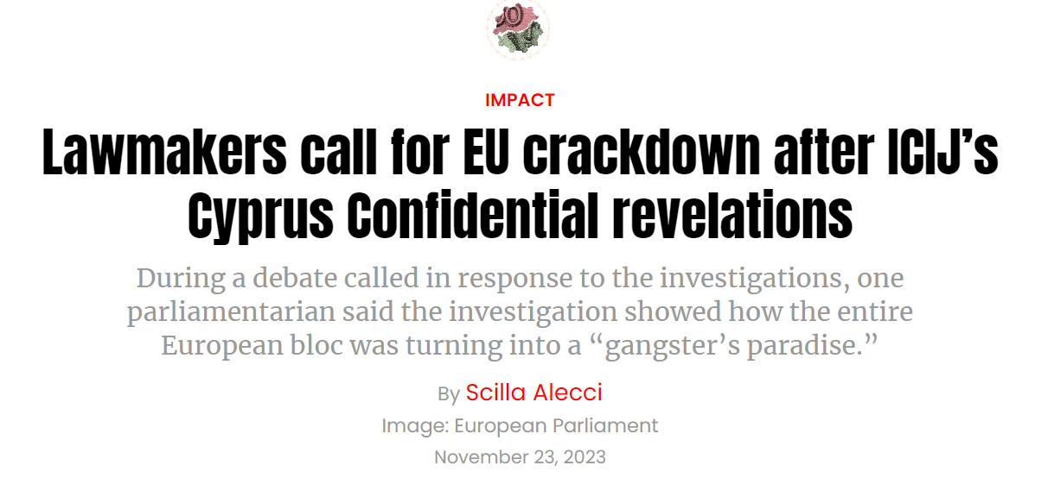
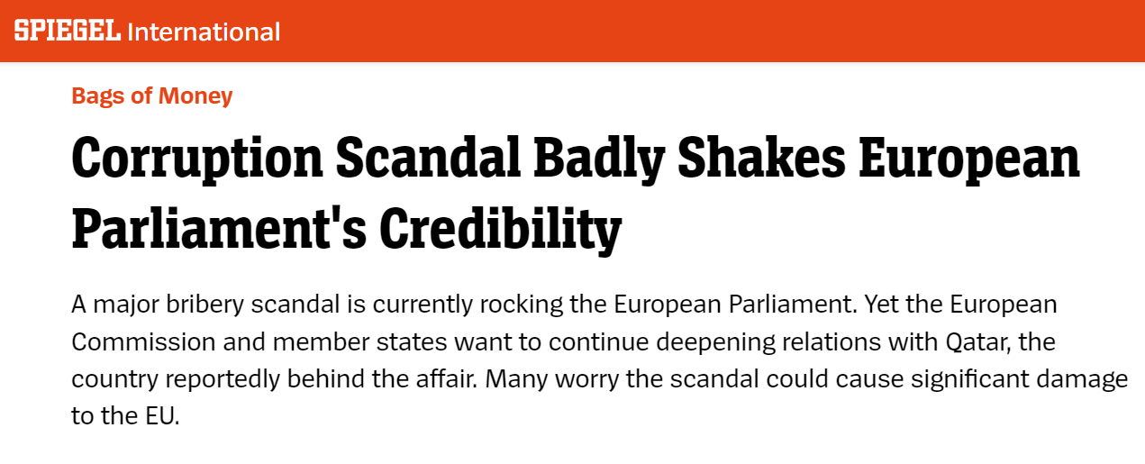
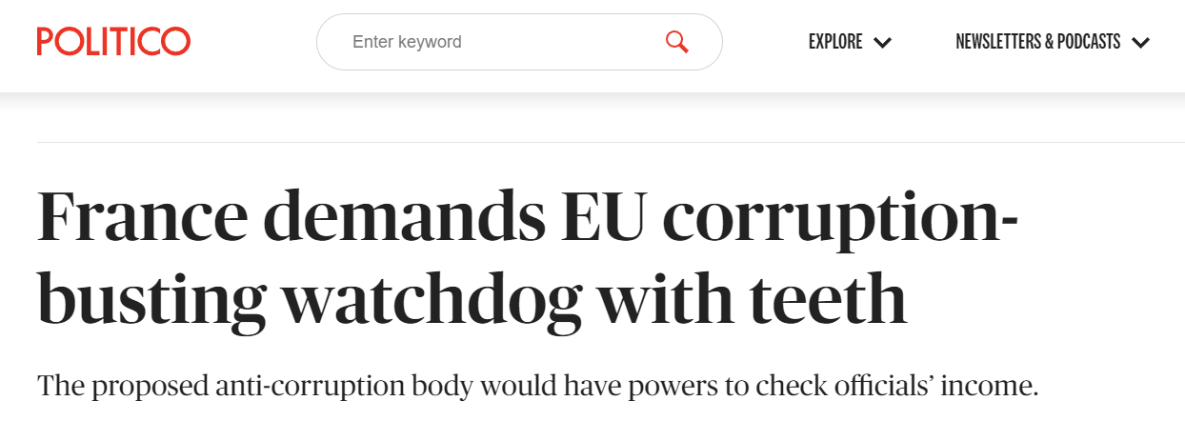
Corruption in public procurement
Corruption = “deliberate restriction of open and fair access to public resources for the benefit of connected actors”
Perennial issue for governments (including adv. democracies)
Consequences:
Slows growth and innovation
Subverts democracy
Compounds inequality
Public procurement accounts for up to 20% of GDP and is vulnerable to corruption
Source: https://www.spiegel.de/international/corruption-scandal-in-the-european-parliament-who-got-the-bags-of-money-a-10e736f6-108a-472f-8fc2-77c6f48dea2a
https://www.icij.org/investigations/cyprus-confidential/lawmakers-call-for-eu-crackdown-after-icijs-cyprus-confidential-revelations/
https://www.politico.eu/article/france-demands-eu-corruption-busting-watchdog-with-teeth/

Slide 31
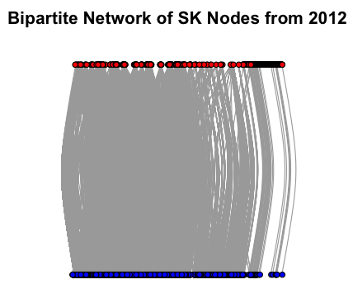
Description: Bipartite Networks

Slide 32
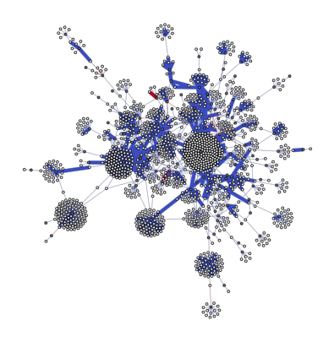
Description: A network in Spring layout
Gray nodes are issuers of contracts.
White nodes are winners of contracts.
The weight of the edges (thickness) indicates the log count of contracts between the issuers and winners.
The color of the edges represents the share of single-bid contracts among these connections; the redder an edge, the higher the proportion of single-bid contracts.
Figure: Slovakia 2012
Figure: Ireland 2012

Slide 33
Description
Plotted on a log–log scale, the degree distributions of both issuers and winners are heterogeneous in all countries: Some rare issuers and winners are involved in hundreds, even thousands of contracts
# of contracts
# of winners
# of issuers
Mean degree for winners
Mean degree for issuers
Density
two measures of the structure of the market: its centralization and the extent too which it is clustered. We then exploit these measures to describe the distribution of corruption risk in each market.
Core-periphery analysis to determine the most central and active nodes
Some empirical networks have a group of densely connected actors at their centers, sometimes called cores [68]. Besides highlighting important actors, methods to detect network cores can be used to compare the degree of centralization in a network. In this subsection, we adapt a method known as k-shell decomposition to weighted bipartite networks in order to rank issuers and winners by their centrality in the network. We say that the most central actors form the core of the market. We measure and compare the relative sizes of the cores of each procurement market, interpreting a larger core as a signal of procurement market centralization. We find a strong correlation between market centralization and corruption risk."

Slide 34

Dataset: EU procurement contract networks (2008-2016)
26 EU countries (excluding Luxembourg, Malta and Croatia) + United Kingdom + Norway
EU law requires public contracts above a certain amount to be published on Tenders Electronic Daily
4M+ public contracts (2008-2016)
Bipartite networks of public institutions (“buyers/issuers”) and firms (“suppliers/winners”)
Single-bid rates used as a proxy for corruption
Source: Eurostat (2020), Wachs, Fazekas and Kertesz (2019)

Slide 35
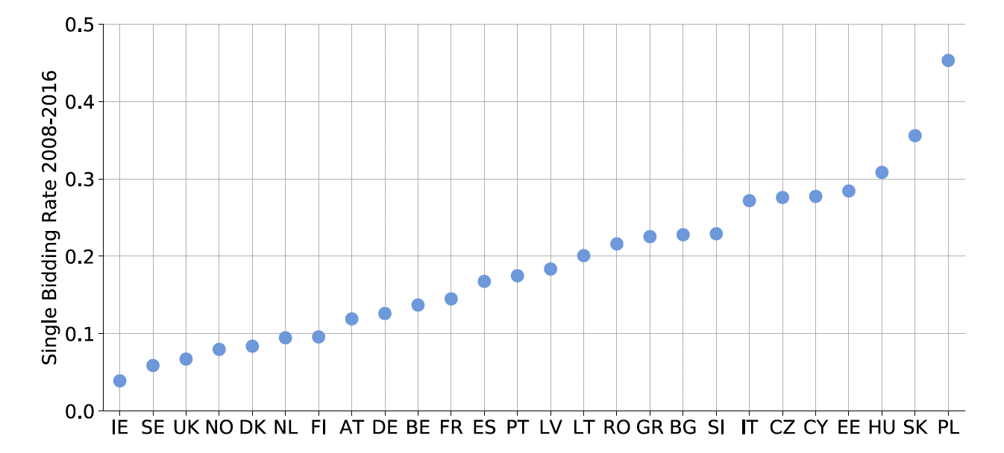
Corruption
Fig. 1 Single-bidding rates on procurement contracts on TED, 2008–2016 by country

